Slide 1
Combinational Circuits
Output is function of input only
  i.e. no feedback
  When input changes, output may change (after a delay)
Combinational
Circuits
n inputs
m outputs
•
•
•
•
•
•
✗
Notes:
Princess Sumaya University
4241 - Digital Logic Design
Dr. Bassam Kahhaleh

Slide 2
Decoders
In digital electronics, a binary decoder is a combinational logic circuit that converts binary information from the n coded inputs to a maximum of 2ⁿ unique outputs
Extract “Information” from the code

Slide 3
Decoders
A decoder has
  N inputs
  2^{N} outputs
A decoder selects one of 2^{N} outputs by decoding the binary value on the N inputs.
Known as n-to-m-line decoder (m = 2^{n}).

Slide 4
Decoders
In general, for an n-bit code, a decoder could select up to 2^{n} lines:
n-bit
code
n to 2^{n}
decoder
2^{n}
output lines
:
:

Slide 5
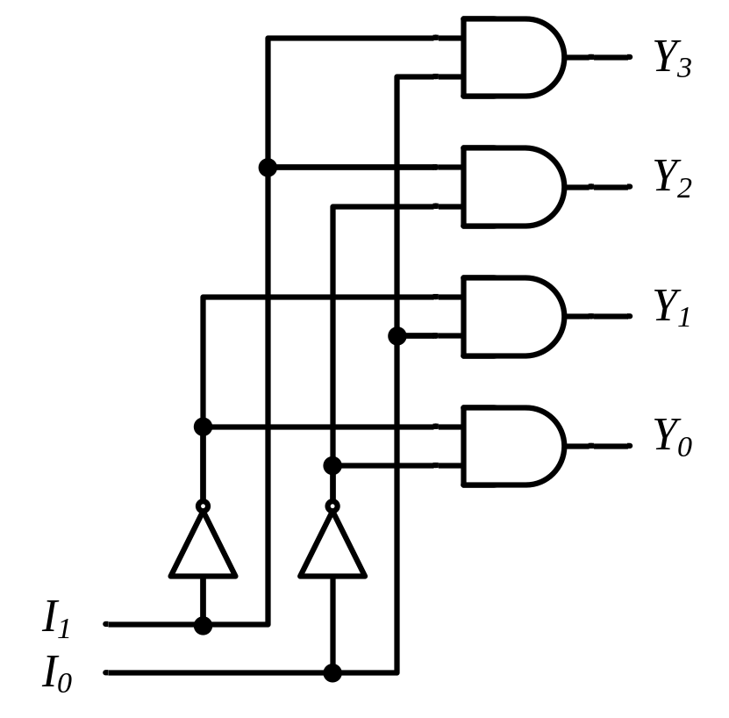
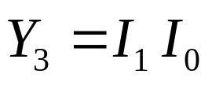
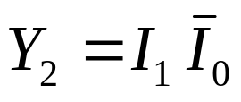
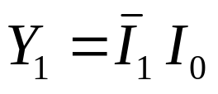
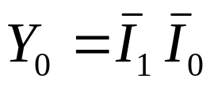
Decoders
2-to-4 Line Decoder
Binary
Decoder
y₃
y₂
y₁
y₀
I₁
I₀
I₁ I₀ | Y₃ Y₂ Y₁ Y₀
0 0 | 0 0 0 1
0 1 | 0 0 1 0
1 0 | 0 1 0 0
1 1 | 1 0 0 0
Notes:
Princess Sumaya University
4241 - Digital Logic Design
Dr. Bassam Kahhaleh

Slide 6
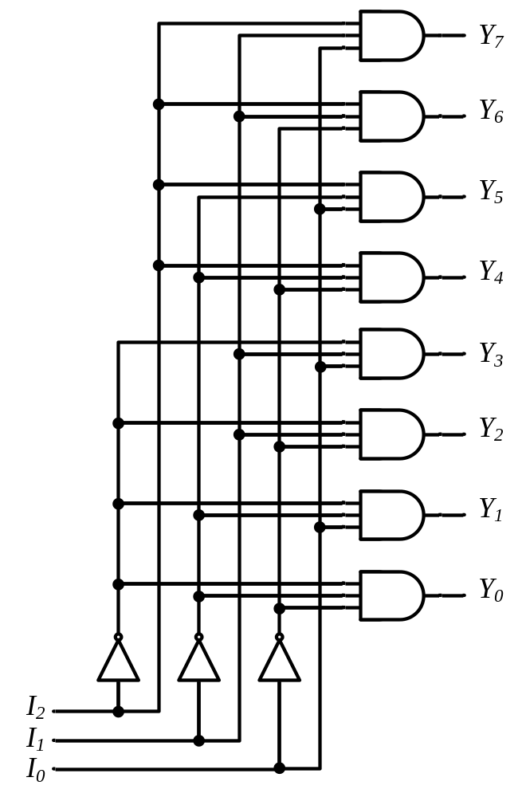






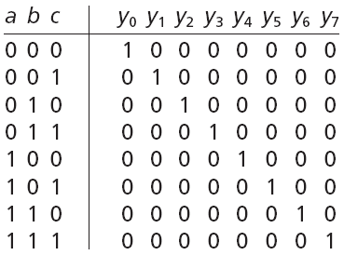


Decoders
3-to-8 Line Decoder
Binary
Decoder
Y₇
Y₆
Y₅
Y₄ Y₃
Y₂
Y₁
Y₀
I₂
I₁
I₀
Notes:
Princess Sumaya University
4241 - Digital Logic Design
Dr. Bassam Kahhaleh

Slide 7
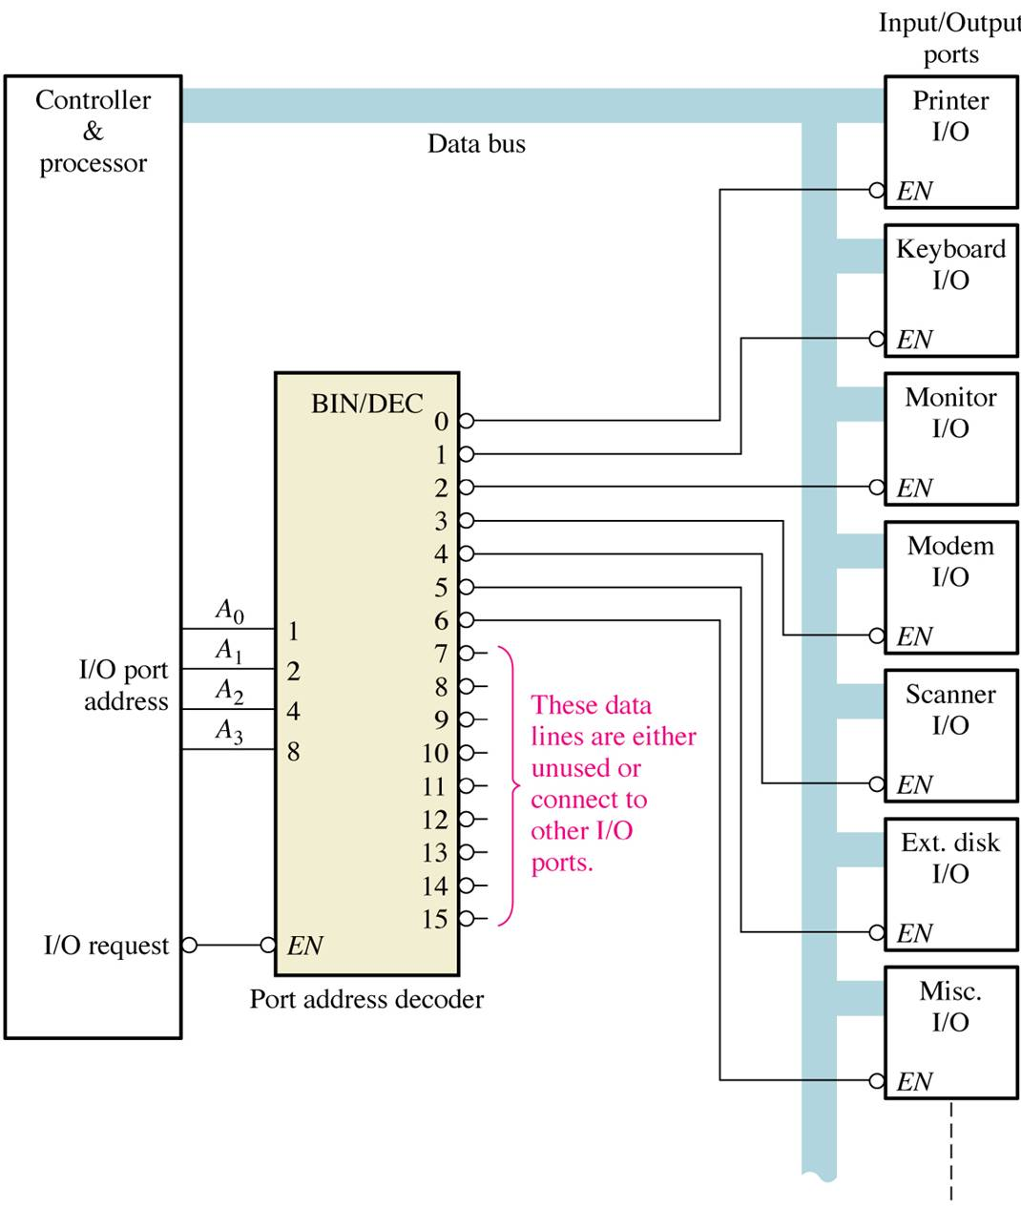
Application example
A simplified computer I/O port system with a port address decoder with only four address lines shown.

Slide 8
Decoders are used in many types of applications. One example is in computers for I/O selection
Computer must communicate with a variety of external devices called peripherals by sending and/or receiving data through what is known as input/output (I/O) ports
Each I/O port has a number, called an address, which uniquely identifies it. When the computer wants to communicate with a particular device, it issues the appropriate address code for the I/O port to which that particular device is connected . The binary port address is decoded and appropriate decoder output is activated to enable the I/O port
Binary data are transferred within the computer on a data bus, which is a set of parallel lines

Slide 9
Decoder Applications
• Microprocessor memory systems
– selecting different banks of memory
• Microprocessor input/output systems
– selecting different devices (printer, serial, video etc)
• Microprocessor instruction decoding
– enabling different functional units within the uP.
• Memory chips
– enabling different rows of memory depending on inputted address
• Identifying or selecting various circuit options.
Can also be used for logic synthesis since each output actually
represents a unique minterm of the inputs
Used in counter systems
Used in Analog to Digital Converters
Decoder outputs can be used to drive a display systems

Slide 10
Encoders
The combinational circuits that change the binary information into N output lines are known as Encoders. The binary information is passed in the form of 2^{N} input lines. The output lines define the N-bit code for the binary information.
An encoder has
  2^{N} inputs
  N outputs
An encoder outputs the binary value of the selected (or active) input.

Slide 11
An encoder performs the inverse operation of a decoder.
Issues
  What if more than one input is active?
  What if no inputs are active?

Slide 12
Encoder
An encoder is a combinational logic circuit that essentially performs a “reverse” of decoder functions.
An encoder accepts an active level on one of its inputs, representing digit, such as a decimal or octal digits, and converts it to a coded output such as BCD or binary.
An encoder has a number of input lines, only one of which input is activated at a given time and produces an N-bit output code, depending on which input is activated.

Slide 13
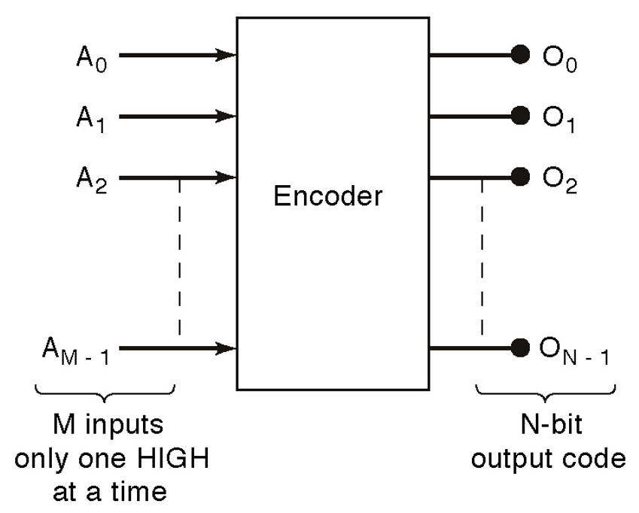
General encoder diagram

Slide 14
Encoders
D
I₀
C
I₁
Out₀
Z
Out₁
Y
B
I₂
A
I₃
A | B | C | D | Y | Z
0 | 0 | 0 | 1 | 0 | 0
0 | 0 | 1 | 0 | 0 | 1
0 | 1 | 0 | 0 | 1 | 0
1 | 0 | 0 | 0 | 1 | 1

Slide 15
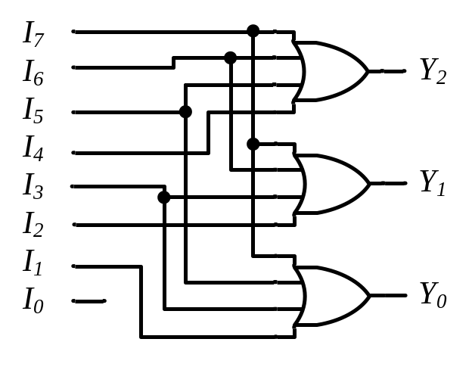
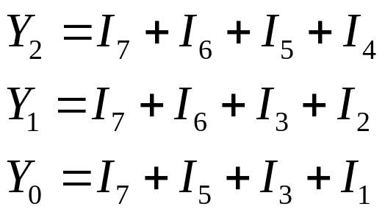
Encoders
Binary
Encoder
Octal-to-Binary Encoder (8-to-3)
I₇
I₆
I₅
I₄ I₃
I₂
I₁
I₀
I₇ I₆ I₅ I₄ I₃ I₂ I₁ I₀ | Y₂ Y₁ Y₀
0 0 0 0 0 0 0 1 | 0 0 0
0 0 0 0 0 0 1 0 | 0 0 1
0 0 0 0 0 1 0 0 | 0 1 0
0 0 0 0 1 0 0 0 | 0 1 1
0 0 0 1 0 0 0 0 | 1 0 0
0 0 1 0 0 0 0 0 | 1 0 1
0 1 0 0 0 0 0 0 | 1 1 0
1 0 0 0 0 0 0 0 | 1 1 1
Y₂
Y₁
Y₀
Notes:
Princess Sumaya University
4241 - Digital Logic Design
Dr. Bassam Kahhaleh

Slide 16
Encoder Design Issues
  Only one input can be active at any given time.
    If two inputs are active simultaneously, the output produces an undefined combination
      (for example, if D₃ and D₆ are 1 simultaneously, the output of the encoder will be 11 at A1
A₀ = D₁ + D₃ + D₅ + D₇
A₁ = D₂ + D₃ + D₆ + D₇
A₂ = D₄ + D₅ + D₆ + D₇

Slide 17
Priority Encoders
If more than one input is active, the higher-order input has priority over the lower-order input.
  The higher value is encoded on the output
A valid indicator, v, is included to indicate whether or not the output is valid.
  Output is invalid when no inputs are active
    v = 0
  Output is valid when at least one input is active
    v = 1

Slide 18
Priority Encoders-
A 4 to 2 priority encoder has four inputs I3, I2, I1 & I0 and two outputs Y1 & Y0. Here, the input, I3 has the highest priority, whereas the input, I0 has the lowest priority. In this case, even if more than one input is ‘1’ at the same time, the output will be the binarycode corresponding to the input, which is having higher priority.
Multiple asserted inputs are allowed; one has priority over all others.

Slide 19
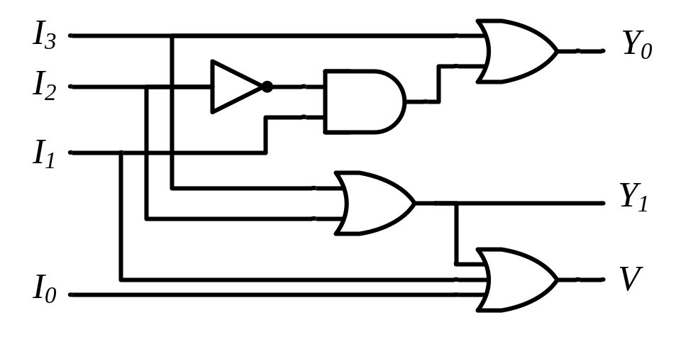
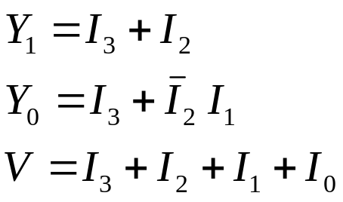
4-Input Priority Encoder
Priority
Encoder
I₃
I₂
I₁
I₀
V
Y₁
Y₀
I₃ I₂ I₁ I₀ | Y₁ Y₀ | V
0 0 0 0 | 0 0 | 0
0 0 0 1 | 0 0 | 1
0 0 1 x | 0 1 | 1
0 1 x x | 1 0 | 1
1 x x x | 1 1 | 1
Y₁ |  |  |  | I₁
 |  | 1 | 1 | 1 | 1 | I₂
I₃ |  | 1 | 1 | 1 | 1
 |  | 1 | 1 | 1 | 1
 |  |  | I₀
Notes:
Princess Sumaya University
4241 - Digital Logic Design
Dr. Bassam Kahhaleh

Slide 20

Encoder / Decoder Pairs
Binary
Encoder
Binary
Decoder
Y₇
Y₆
Y₅
Y₄ Y₃
Y₂
Y₁
Y₀
7
7
I₇
I₆
I₅
I₄ I₃
I₂
I₁
I₀
6
6
5
5
Y₂
Y₁
Y₀
I₂
I₁
I₀
4
4
3
3
2
2
1
1
0
0
Notes:
Princess Sumaya University
4241 - Digital Logic Design
Dr. Bassam Kahhaleh

Slide 21
WATCH DOG TIMER
A watchdog timer (WDT) is a piece of hardware that can be used to automatically detect software faults
Watchdog Timer (WDT) can be helpful to automatically reset the system whenever a timeout occurs.

Slide 22
LPC2148
LPC2148 has an inbuilt watchdog timer. The watchdog when enabled generates a system reset if the user program fails to feed (or reload) the watchdog within a predetermined amount of time.
A watchdog timer can generate a NMI(Non maskable interrupt) or a reset when a time-out value is reached

Slide 23
.The microcontroller has two Watchdog Timer Modules Watchdog Timer 0 is clocked by the system clock
Watchdog Timer 1 is clocked by the PIOSC Watchdog Timer can be configured to generate an interrupt to the microcontroller on its first time-out, and to generate a reset signal on its second time-out.

Slide 24
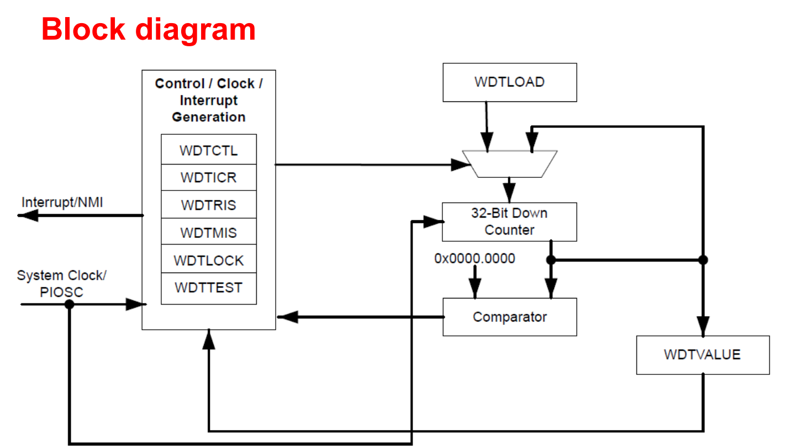

Slide 25
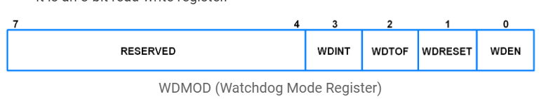
Watchdog Registers
Bit 0 – WDEN (Watchdog Interrupt Enable)
Bit 1 – WDRESET (Watchdog Reset Enable)
Bit 2 – WDTOF (Watchdog Time-Out Flag)
This bit is set when the watchdog times out.It is cleared by software.
Bit 3 – WDINT (Watchdog Interrupt Flag)
This bit is set when the watchdog times out. This bit is cleared when any reset occurs.

Slide 26
functional Description After being enabled, the WDT generates the first time-out signal when the 32-bit counter reaches 0.
Enabling the counter also enables the watchdog timer interrupt After the first time-out event,
the value of the Watchdog Timer Load (WDTLOAD) register is load the 32 bit counter Once the WDT has been configured,

Slide 27
the Watchdog Timer Lock (WDTLOCK) register can be written to prevent the timer configuration from being altered by software
If timer counts down to zero, before completing to process (the first time-out) then cannot do interrupt clearing process
and the reset signal has been enabled by setting the RESEN bit in the WDTCTL register,

Slide 28
The 32-bit counter is loaded with the value in the WDTLOAD register, and counting resumes from that value.
If WDTLOAD is written with a new value while the Watchdog Timer counter is counting,
Any previous interrupt observed. It must cleared by writing to the Watchdog Interrupt Clear (WDTICR) register

Slide 29
The operation of the watchdog is controlled by the 16-bit register WDTCTL register.
Watchdog Value (WDTVALUE) This register contains the current count value of the timer.
Other Registers Watchdog Raw Interrupt Status (WDTRIS) Watchdog Masked Interrupt Status (WDTMIS) Watchdog Test (WDTTEST)

Slide 30
TIMER PROGRAMS

Slide 31
Programming Timer0 and 1 in 8051 C:
In this section we study C programming for the 8051 timers. The general purpose registers such as R0-R7, A and B are not directly accessible by the C compiler, while the SFRs and RAM space 80-FFH is directly accessible using 8051 C statements.

Slide 32
Accessing timer registers in C
In 8051 C we can access the timer registers TH, TL and TMOD directly using the reg51.h header file.
This is shown through example. This example also shows how to access the TR(TIMER RUN) and TF(OVER FLOW FLAG) bits

Slide 33
Write an 8051 C program to toggle only bit P1.5 continuously every 50ms. Use Timer 0, mode 1 (16-bit) to create the delay.
Assume XTAL=11.0592 MHz=>
T=1.085μs
Count=50ms/1.085μs =46083
Initial count-8BIT = 65536-46083 =19453
Count in Hex = 4BFDH(DECIMAL TO HEX)

Slide 34
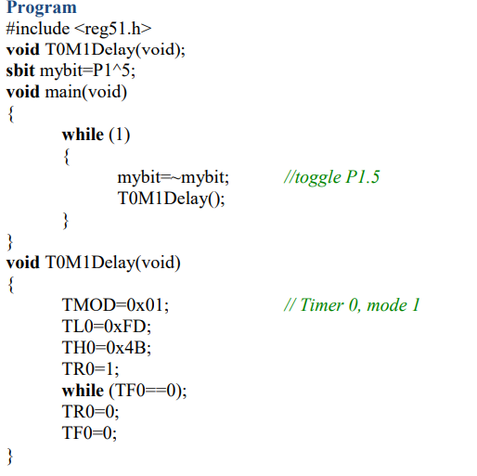


Slide 35
ASSEMBLY OR C PROGRAM
Write an 8051 C/ASM program to toggle all the bits of port P1 continuously with some delay in between.
Use Timer 0, 16-bit mode to generate the delay.
P1 ADDRESS = Ox55
P1 CONNECT WITH DECIMAL-65536 = FFFF(H)
1 MACHINE CYCLE = 1.085
SET TIMER HIGHER = LESS THAN Ox20(55-20=Ox35)

Slide 36
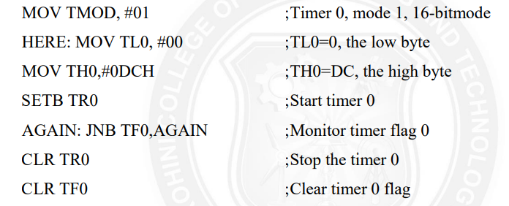

Slide 37
